Slide 1
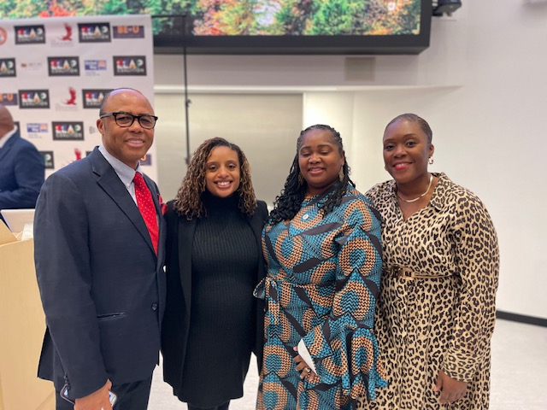

Literacy Proficiency
Math Proficiency
Chronic Absenteeism & Retention
Parent Engagement
Community
Superintendent
Dr. Eric L. Blake
Deputy Superintendent
Dr. Shonelle Hall
February 6, 2025
“With effort and support all schools can meet the needs of their students and help them achieve outstanding educational outcomes”

Slide 2
District 28 Vision, Mission & Goals
The United Nations' mission statement includes the line, "In this noble undertaking, cooperation, collaboration, unity, and solidarity must be the light we should seek and follow. We commit to strive for inestimable contribution to human progress."
Mission
In Community School District 28 we focus on equity as a lever for achievement for every single scholar. We are a district of excellence. We commit to every school maintaining high academic standards and working closely with families so that all scholars are learning at high levels. Beginning with school leaders, teachers, students and community partners, we also commit to being a district of learners ensuring that we promote critical thinking rooted in core content conceptual understanding through creative problem solving, technology innovation, social emotional learning and community advocacy.
Vision
In Community School District 28 we celebrate our differences because we understand that woven into those differences is the knowledge that they offer us unlimited possibility to learn and expand our knowledge of and commitment to all humanity. We are beautifully diverse, varied; coming from countless racial, ethnic, language, and belief backgrounds. We commit to striving for inestimable contribution to the lives of our scholars.

Slide 3

New York State Testing Dates
New York State Grades 3–8 English Language Arts (ELA) - Main Administration | Paper-based Testing (PBT): April 29 – 30, 2025 Computer-based Testing (CBT): April 22 – May 2, 2025
New York State Grades 3-8 English Language Arts (ELA) - Make Up Administration | Paper-Based Testing (PBT): May 1 – 6, 2025
New York State English as a Second Language Achievement Test (NYSELAT) | April 14 – May 23, 2025 (Speaking) May 12 – 23, 2025 (Reading, Writing, Listening)
New York State Grades 3–8 Math - Main Administration | Paper-Based Testing (PBT): May 7 – 8, 2025 Computer-based Testing CBT: May 6 – 16, 2025
New York State Grades 3–8 Math - Make Up Administration | Paper-Based Testing (PBT): May 9 – 14, 2025
New York State Grades 5 & 8 Science | May 13 – 16, 2025
​
Academic Sprint:
All schools are providing targeted support for students in need.

Slide 4
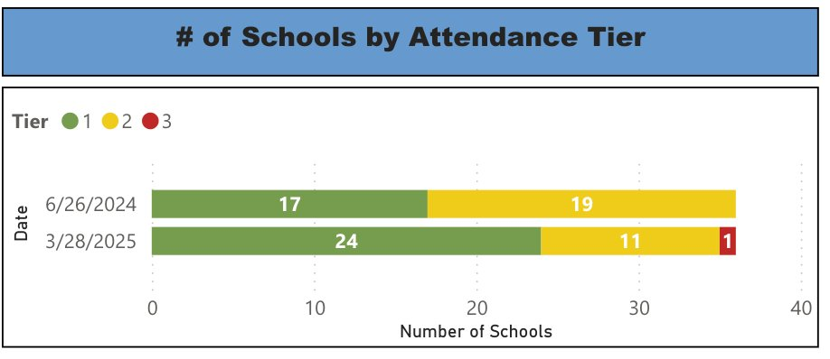
D28 Attendance Update
Target Population | Baseline Data | SMART Goal
Overall Attendance: All Students | 90.4% District Wide | By June 2025, we will increase district-wide attendance by 2 percentage points from 90.7% to 92.7% excluding students who are long-term international travelers.
Students At Risk Of Being Chronically Absent | 36% District Wide | By June 2025, we will reduce overall chronic absenteeism by 10% of overall Chronically Absent Students EOY 23/24 from 35% to 31%, excluding students who are long-term international travelers.
District 28 Schools: 36 Schools (1 Pre-K center, 8 MS, and 27 Elem) - metrics exclude Pre-K center as of 3/25/25​
​
Attendance Rate: Citywide 90.0% and D28 91.2%​
  End of March 2024 D28 was 90.9%, showing IMPROVEMENT​
28/35 Schools Had Attendance Rate greater than or equal to 90%​

Slide 5
Commitment to Protecting our Students
NYCPS and the Mayor’s Office protect every student's right to attend public school, regardless of immigration status, national origin, or religion.
Non-local law enforcement agents, including ICE personnel, are not permitted to enter schools unless required by law.
NYCPS must honor valid judicial warrants, court orders, and subpoenas, but school officials should show these documents to the Senior Field Counsel (SFC) before taking any action.
School safety agents should alert the school principal or designee and ask the officer to wait outside the building.
Do not provide any information about students, family members, or NYCPS employees; remain calm and connect the officer with the school principal.

Slide 6
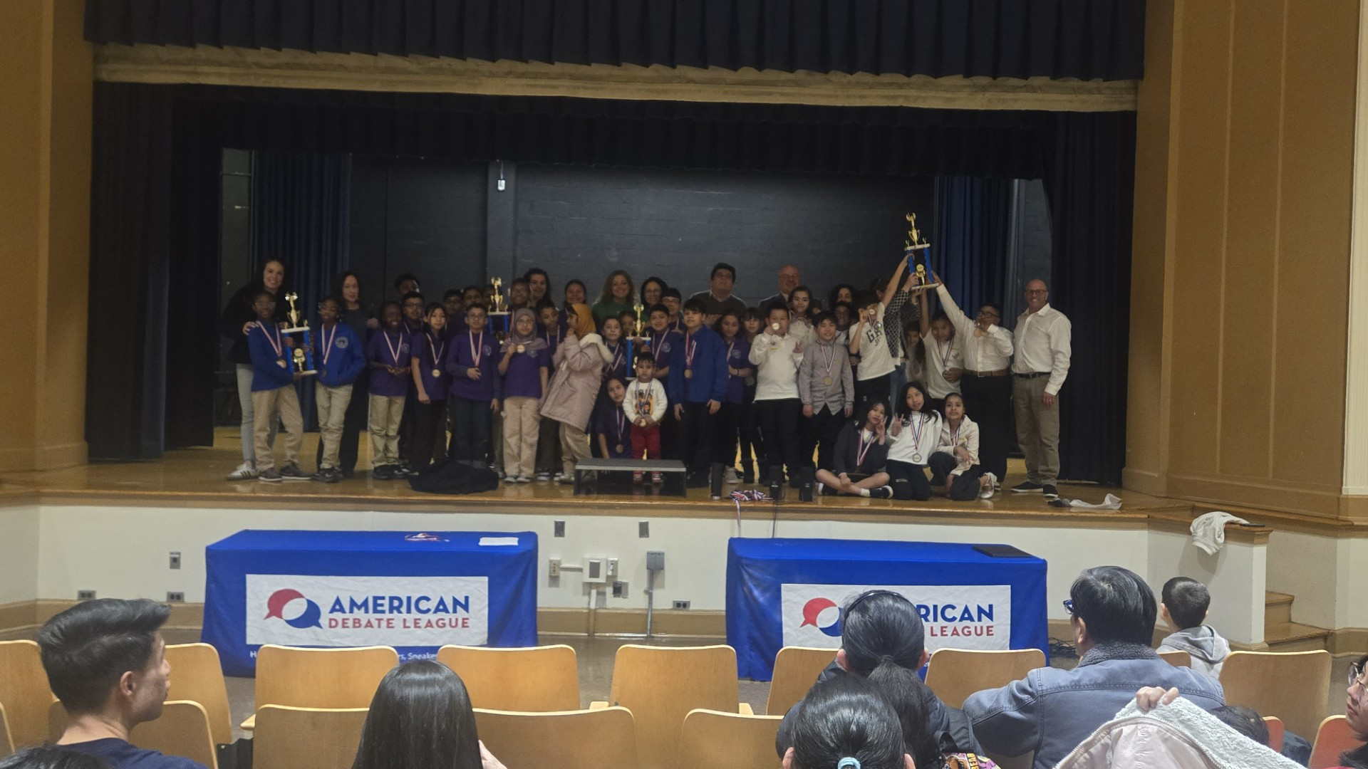
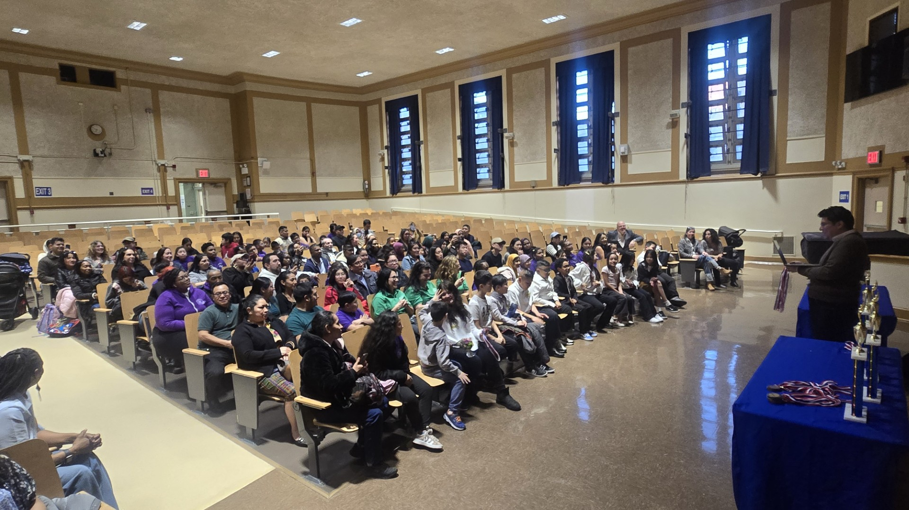
D28 Debate Tournament with The American Debate League (ADL)
american debate league
"helping students to become better thinkers, speakers, & leaders"
Congratulations to three of our Elementary Schools for their participation, and a special thank you to our host school, 28Q190, and Principal Greggo!
28Q139 Principal Eleuterio 28Q312 JCS Principal Cespedes 28Q182 Principal Topol
Over the past few months, staff and students, guided by the ADL, have honed their research and debate skills. This event showcased their hard work, leaving students proud and impressing attendees with their poise and abilities. Special thanks to 28Q182 and Principal Topol, whose teams excelled in a Spanish debate and have been invited to another debate this Spring!

Slide 7
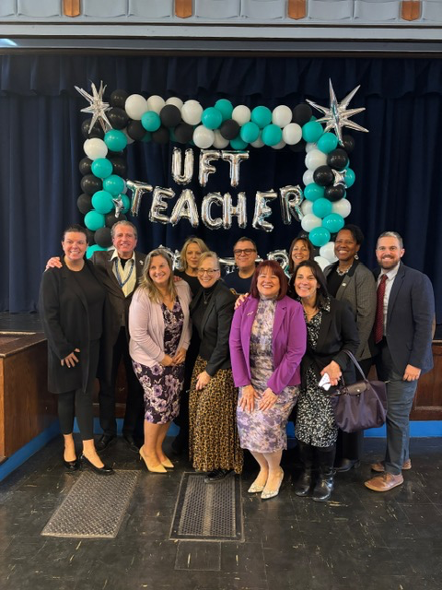
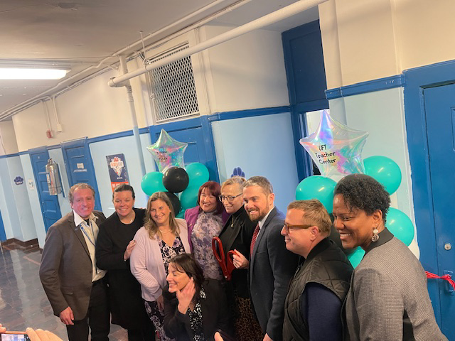
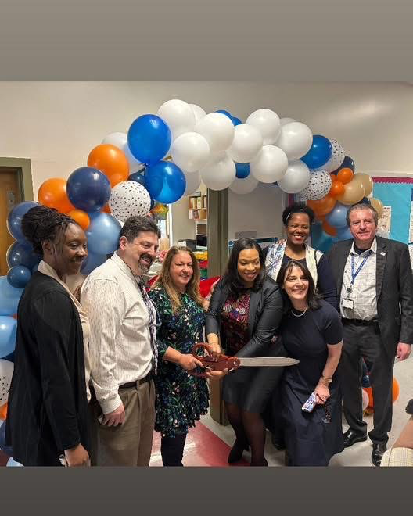
UFT Teacher Centers
We are excited to announce the opening of two new teacher centers at PS 54 and PS 48, dedicated to supporting our educators. This is another example of the fantastic collaboration between the Superintendent's Office and the United Federation of Teachers (UFT). Together, we are committed to enhancing the resources available to our teachers and fostering a thriving educational environment.

Slide 8

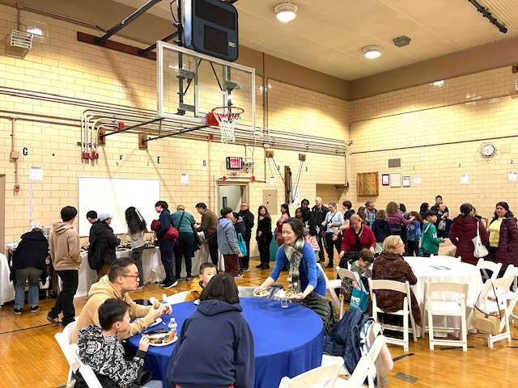
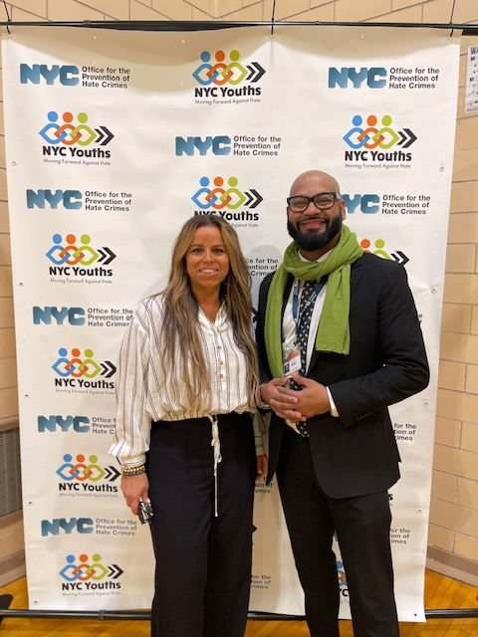
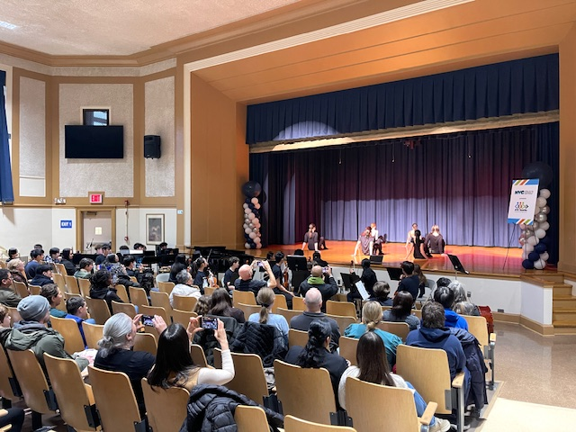
OPHC visits JHS 190
The NYC Office of Prevention of Hate Crimes (OPHC) recently visited JHS 190, engaging students and the school community in a vital discussion on understanding, recognizing, and addressing biases and hate crimes. We extend our heartfelt thanks to our very own Vijah Ramjattan, Executive Director of OPHC, and Principal John Greggo for this invaluable opportunity.

Slide 9
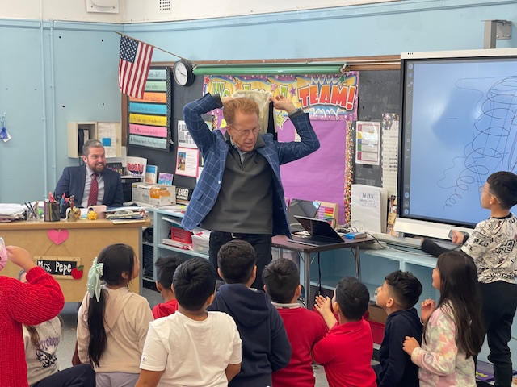
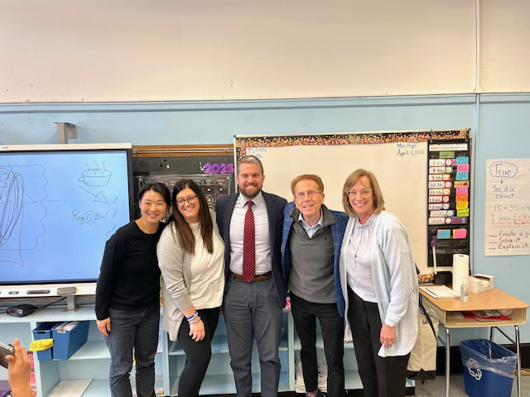
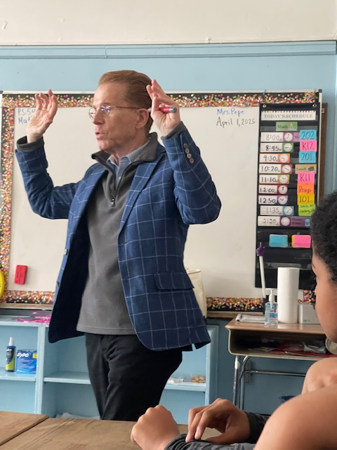
CBS Weatherman John Elliot visits PS 54
PS 54 had the incredible opportunity to host CBS News New York Meteorologist John Elliot, who captivated our students with insights into his career as a weatherman. Mr. Elliot emphasized the crucial role of mathematics and sciences in understanding weather patterns, inspiring our students to appreciate these subjects. He also highlighted how scientific knowledge can help us save and sustain our planet, leaving a lasting impact on our young minds. You are a Stormtrooper, Mr. Elliot! ☺

Slide 10
D28 Hiring Fair
Finally, I am excited to announce the D28 Careers in Education Hiring Fair initiatiev I began last year, held in partnership with York College. This event will provide valuable opportunities for aspiring educators to connect with potential employers and explore career paths in education. Don't miss this chance to shape your future in the field of education!
Date: Tuesday, April 8, 2025
Time: 5:00 P.M – 7:00 P.M

